Slide 1
Project Progress Review #1
Project 14
Electric Vertical Takeoff and Landing (eVTOL) Drone with Outboard Horizontal Stabilizers (OHS)
Nour Almriri, May Chan, Brian Dang, Irfan Khan, Breanna Neubauer, Adnan Sayeed

Slide 2
Project Formulation – reference slide (will be deleted)
Explain design problem (background and design motivation, what are the requirements and how they will be quantified)
Clear formulation of design requirements
Clear relationship to original design objectives
Can include images from Kentfield papers to help visualize the problem/goal
eVTOL and OHS

Slide 3
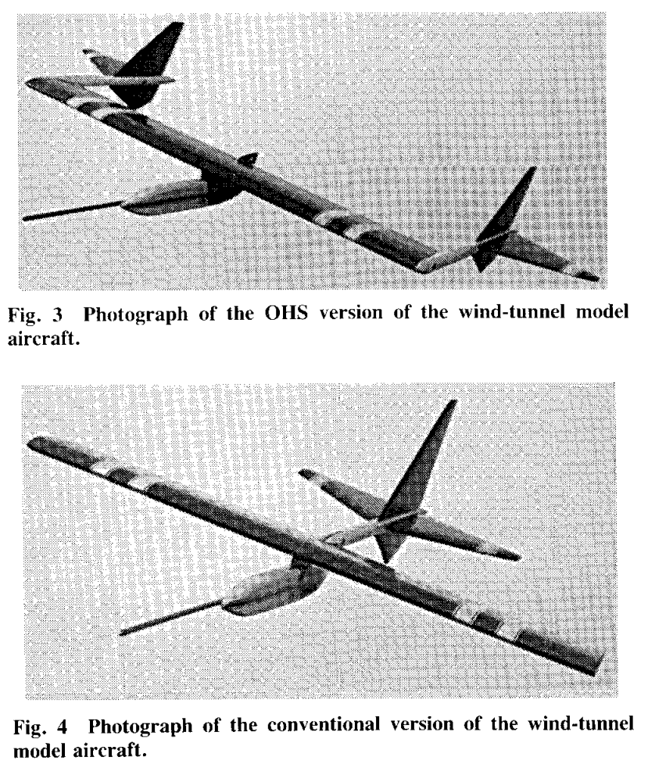
Background and Motivation
Develop and optimize an electric vertical and takeoff landing (eVTOL) drone with outboard horizontal stabilizers (OHS)
Address design and aerodynamic challenges associated with eVTOL operations, focus on enhancing stability and control during transitional fight phase
A prototype is an important validation step for theoretical efforts in Dr. Hinman's research
The OHS configuration splits the conventional vertical/horizontal stabilizers and places them at the ends of the wing tips, in the upwash
Previous efforts show a 30% increase in lift-to-drag ratio with an OHS configuration
Notes:
- explain OHS and why it’s important
- discuss challenges that Ryan came across with takeoff and the need for VTOL now

Slide 4
Design Requirements and Objectives
Prototype and manufacture with lightweight PLA
Expand knowledge in eVTOL field and validate ongoing research efforts in Dr. Hinman's lab
Establish conceptual design, component specifications, cad modelling, and analysis
Design and build a drone less than 250g (meeting aviation regulatory requirements)
Must ensure vertical takeoff and landing and efficient forward flight with OHS
Notes:
- explain LLT code to substitute for CFD
- motor/thurst code for VTOL analysis

Slide 5
Key Deliverables
Semester 1:
Successful VTOL Flight
Semester 2:
Successful VTOL + Forward Flight With OHS Concepts

Slide 6
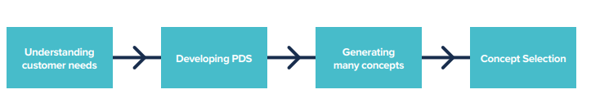


Concept selection
Concept selection is an element of the design process that enables us to pick the ideas that best satisfy the product design specification:
We are designing two planes in one. Both modes should work with and not against each other:

Slide 7
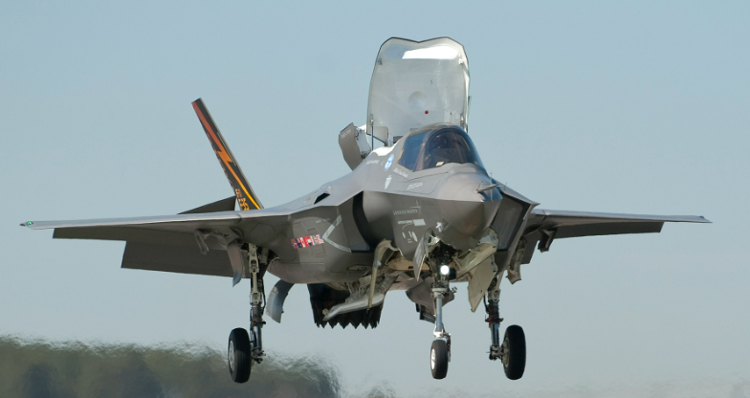
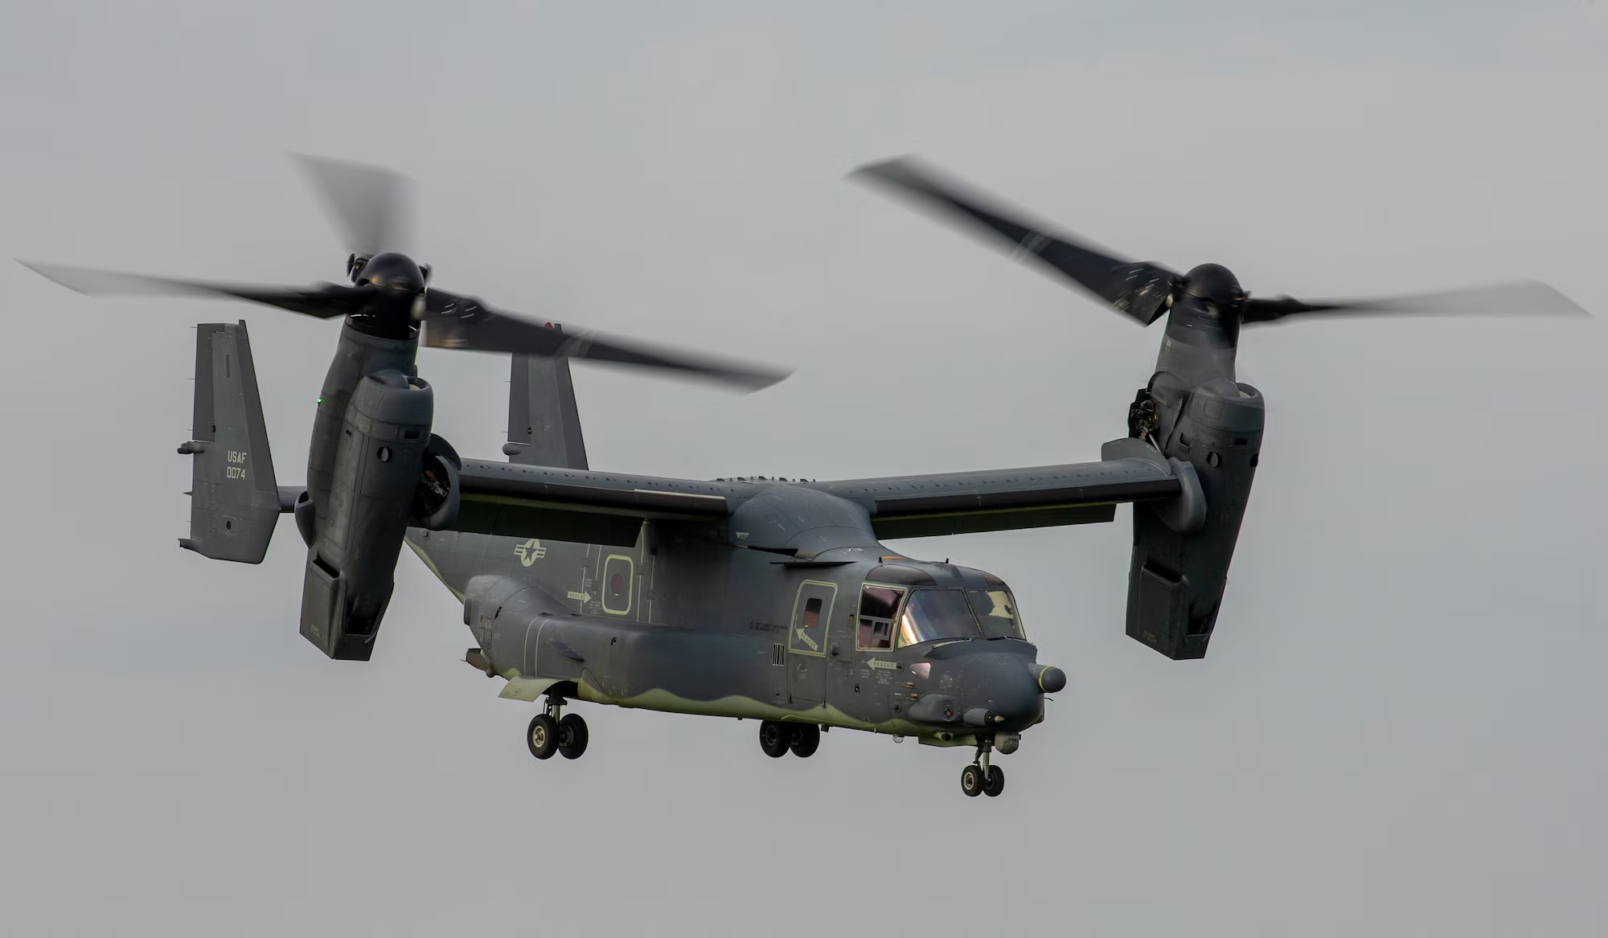
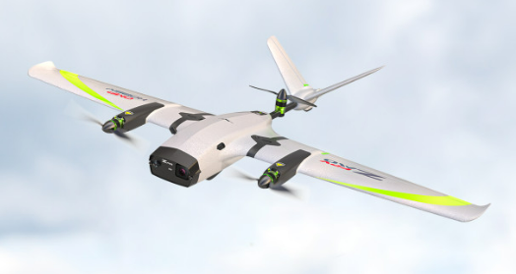
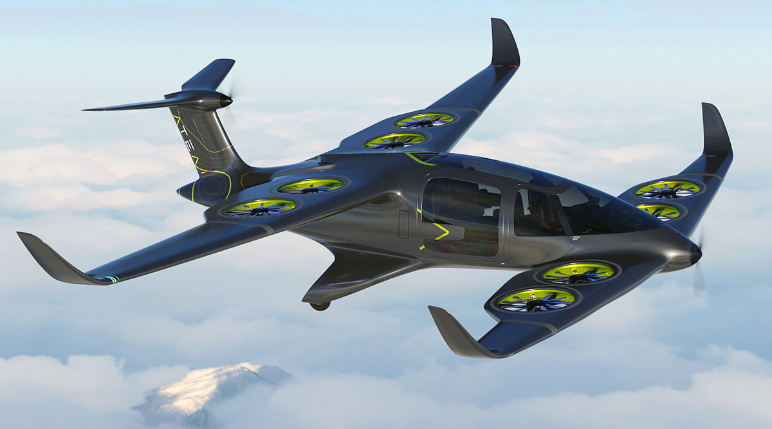
Concept selection
Our first approach was to investigate the literature including previous research and current airplanes in the market. Some include:
The point of this exercise is to collect information to be inspired rather than replicate existing products.
Bell Boeing V-22 Osprey
Lockheed Martin F-35B
ZMO Pro VTOL
Ascendance Flight Atea

Slide 8
Concept selection
After developing the PDS and then looking into the literature, we selected and generated few designs and chose the best ones based on the following rubric:
Parameter | Description | Example
Aerodynamics Efficiency | How effectively our product minimize drag and maximize lift to achieve its objective. | L/D, AR, Range, Endurance
Structural Integrity | The ability of the structure and material to withstand the load requirements and complete mission without structural failure. | Von Mises stress, Bending Moment, Material Fatigue
Control and Stability | The ability of the aircraft to achieved desired maneuvers within a controlled user input. | Euler angles, PID Controller Response
Manufacturability | The ease with which our product can be manufactured within the allocated resources and knowledge. | Manufacturing Method, Equipment used
Cost of design and production | The total cost required to design and build the product. | Canadian Dollar, Cost < Budget
Project timeline adherence | The time required to gain the required skills, resources, and testing done to complete the project. | Weeks, Project Schedule

Slide 9
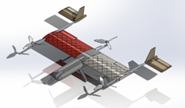
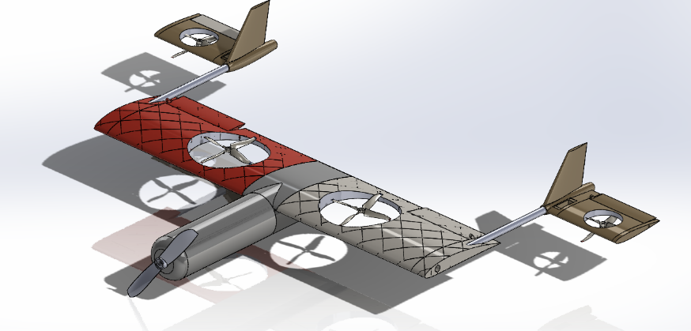
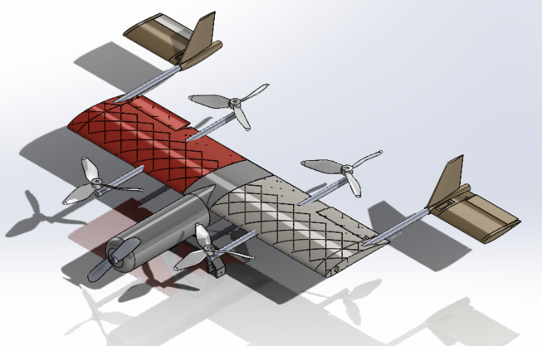
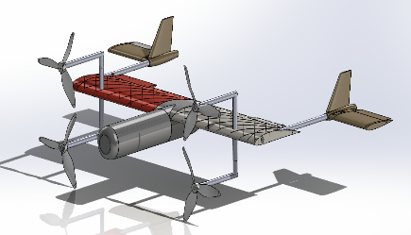
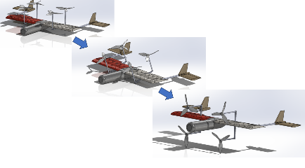
1
2
Top 5 Concepts Rubric (Score out of 5 points for each parameter)
Design | Aerodynamic efficiency | Structural Integrity | Control and Stability | Manufacturing | Cost of design and production | Project Timeline Adherence | Total Score | Relative Score out of 30
1 | 4.5 | 4.5 | 2.5 | 5 | 5 | 3 | 24.5 | 81.7%
2 | 2.5 | 3 | 4.5 | 3 | 4 | 3.5 | 20.5 | 68.3%
3 | 4 | 4 | 4.5 | 4.5 | 4.5 | 5 | 26.5 | 88.3%
4 | 3.5 | 3 | 2.5 | 3 | 3 | 2.5 | 17.5 | 58.3%
5 | 3.5 | 2.5 | 2 | 2.5 | 2 | 1 | 13.5 | 45%
3
4
5

Slide 10
High-Level Project Schedule
13 Nov.
Start of Fall Reading Week:
CAD models completed, avionics gathered, current prototypes 3D printed
19 Nov.
End of Fall Reading Week:
Flight tests completed for current prototypes
22 Dec.
End of Fall Exams:
Successful VTOL flying abilities
18 Feb.
Start of Winter Reading Week:
Prototype re-modelled on SOLIDWORKS, avionics updated (if necessary), new prototypes 3D printed
24 Feb.
End of Winter Reading Week:
Flight test completed for current prototypes
21 Mar.
2 Weeks Out From Design Fair:
Successful VTOL + OHS drone flying abilities

Slide 11






Our Team
NOUR ALMRIRI
Engineering Design Lead
& Quality Control Lead
MAY CHAN
Project Management Lead
& Quality Control Lead
BRIAN DANG
Testing Lead
& Quality Control Lead
IRFAN KHAN
Engineering Design Lead
& Research/Development Lead
BREANNA NEUBAUER
Project Management Lead
& Research/Development Lead
ADNAN SAYEED
Testing Lead
& Research/Development Lead

Slide 12
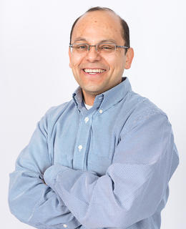
Leadership Roles
Testing Lead:
-> Obtains empirical results, producer of physical prototypes
Project Management Lead:
-> Communication with Dr. Hinman and external resources, scheduling, meeting minutes, room bookings, finances
Quality Control Lead:
-> Verification and validation to ensure codes, model, and avionics are working together
Engineering Design Lead:
-> Creates CAD modelling and simulations, calculations, and codes
Research and Development Lead:
-> Researches designs, materials, controls, concepts

Slide 13
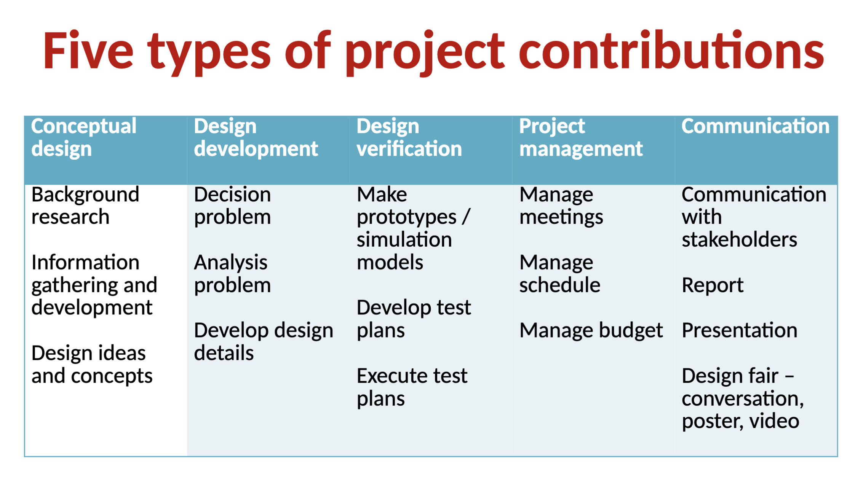
***Use for Reference with Following Slide*** THIS SLIDE WILL GET DELETED

Slide 14
Project Contribution Rubric
Type of Contribution | Nour | May | Brian | Irfan | Breanna | Adnan
Engineering Design | Produced initial VTOL design ideas (#) | Produced initial VTOL design ideas (#) | Produced initial VTOL design ideas (#) | Produced initial VTOL design ideas (#) | Produced research on initial material ideas (3D printing, foam, balsa wood, forged carbon fiber) and general VTOL design concepts | Produced initial VTOL design ideas (#)
Design Development | Wrote MATLAB thrust code (expand on) |  |  | Wrote MATLAB thrust code (expand on) | Researched controls (ESC, receiver, motors, props, etc.) and provided recommendations
Design Verification | Verified MATLAB thrust code | Involved with motor testing (photo/video documentation of process) Verified MATLAB thrust code | Modelled motor testing apparatus Involved with motor testing (troubleshooted apparatus) Verified MATLAB thrust code | Verified Simulink Thrust calculations | Involved with motor testing (provided MEGA 2560 kit, recorded data in excel) | Cleaned-up current SW model Completed 3D prints Involved with motor testing (circuit board assembly)
Project Management | Initiates communication for meetings and sets/follows up with group deadlines | Finance management with sponsor Room bookings |  |  | Records all meeting minutes Room bookings Organized design binder folders on Teams | Room bookings
Communication | Responsible for “design rubric” and “concept selection” slides (#) | Communication with sponsor and external resources Responsible for “project formulation” slides (#) | Responsible for “project formulation” slides (#) | Responsible for “to date” slides (#) | Communication with sponsor and external resources Responsible for “deliverables, schedule, and roles” slides (#) | Responsible for “concept selection” slides (#) and producing SOLIDWORKS model images throughout PowerPoint

Slide 15
To Date reference slide (will be deleted)
Include small summaries of what we have done so far and who has done what
Matlab (Thrust) Code: Nour and Irfan (Validation: Brian and May)
Motor Code: Adnan
Motor and Prop Testing: Adnan, Brian, Breanna, May
Controls Research: Breanna
3D Model: Adnan
General Housekeeping and Communications w/ Supervisor: Breanna and May

Slide 16
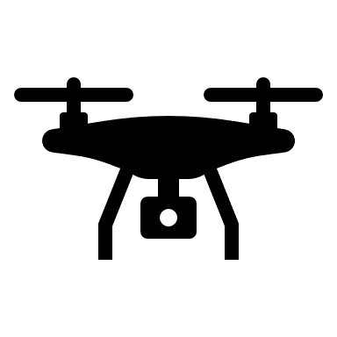





To Date
Motor Code (MATLAB):
Adnan Sayeed
3D CAD Modelling:
Adnan Sayeed
Controls Research: Breanna Neubauer
Motor and Propellor Testing:
Adnan Sayeed, Brain Dang, Breanna Neubauer & May Chan
Thrust Code (MATLAB):
Nour Almriri, Irfan Khan (Verification – May Chan & Brain Dang)
Communication and Project Management
Breanna Neubauer and May Chan

Slide 17
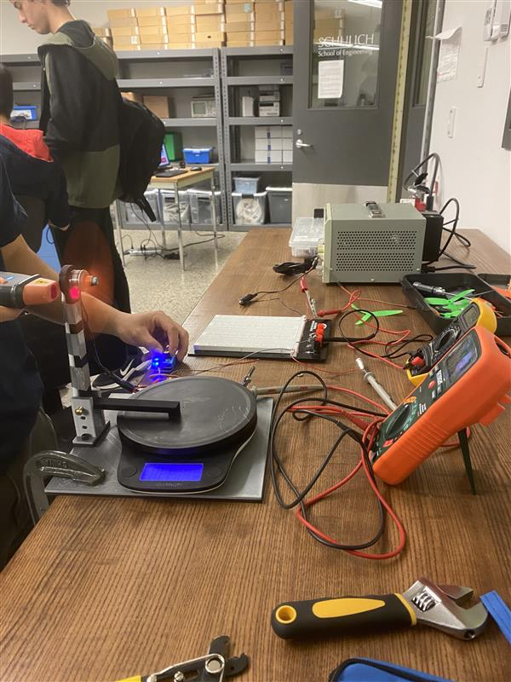
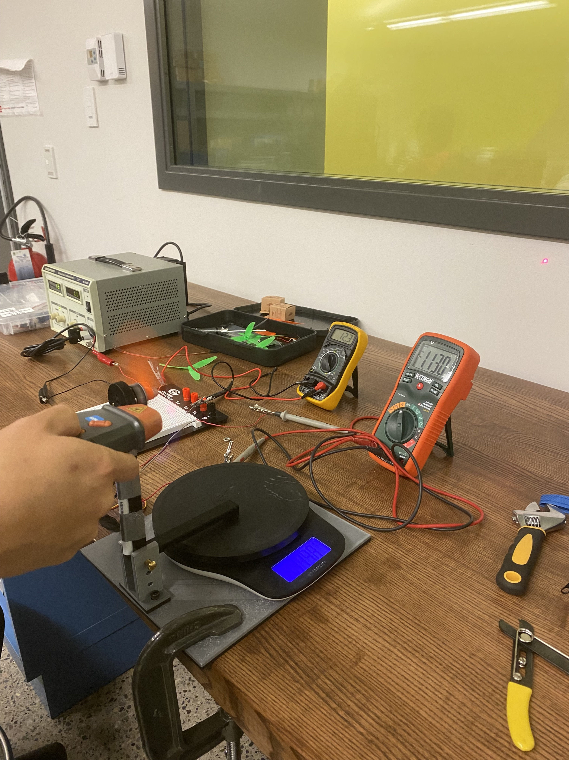
Motor & Propellor
Testing
Collected empirical data on the thrust, RPM and voltage
Compared thrust generated by different propellors
Motor Code
MATLAB code to find relationship between thrust generated and RPM
Found the coefficients of motion required for the Thrust Code
3D CAD Modelling
Generated CAD models in SolidWorks
Used to find Mass Moment of Inertia and Center of Gravity for Thrust Code
Notes:
- briefly explain experiment setup and method
- present data collected (display??)

Slide 18
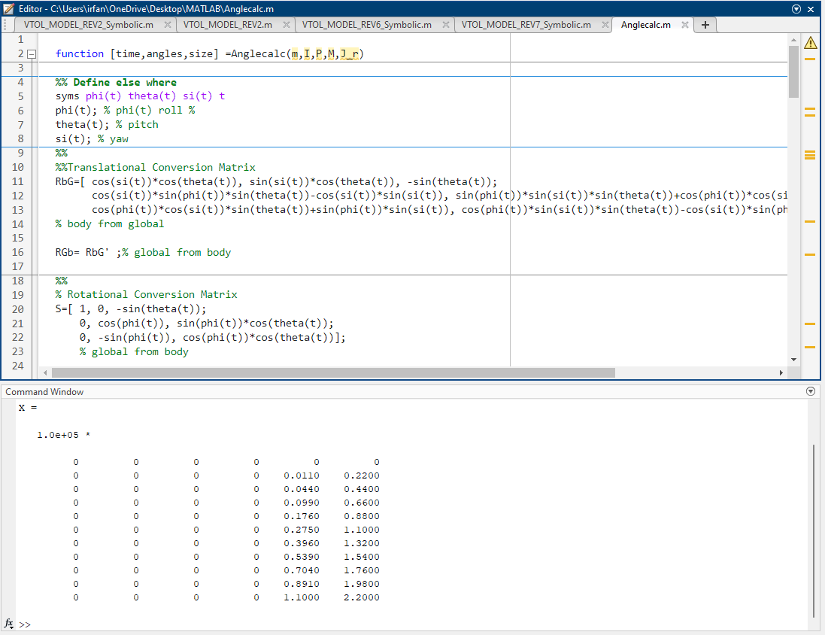
Thrust Code
MATLAB and Simulink used to model the dynamics of different concept designs
Used mathematical values derived from both Motor Code and SolidWorks models
Used initial input values of thrust to compute the dynamics of the drone in vertical flight (VTOL mode)
Compared different the efficiency of different concept designs
Controls Research
Preliminary testing done with controls from provided 410 kits and MEGA 2560 kit
Communication &
Project Management

Slide 19
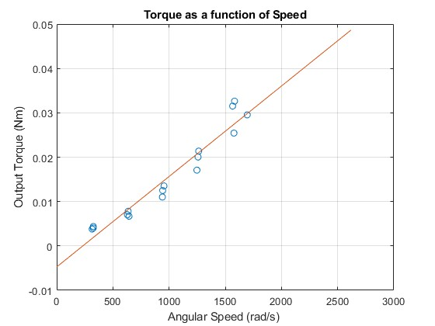
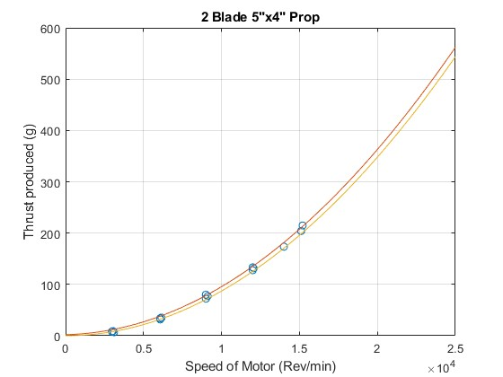
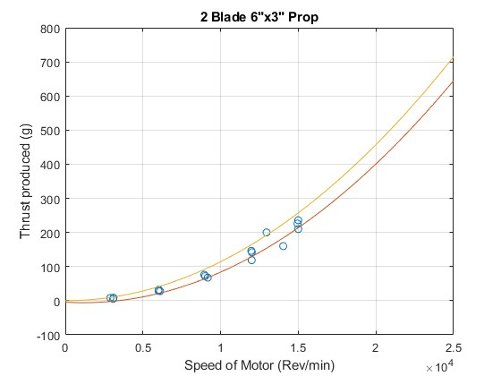
Motor Code
MATLAB code to compute and plot the theoretical relationship between thrust and RPM of motor
Plot graphs used to compare different prop designs
Derive coefficients of motion used in dynamics calculations in the Thrust Code
Notes:
- explain how empirical data was used to derive mathematical correlations
- exp

Slide 20

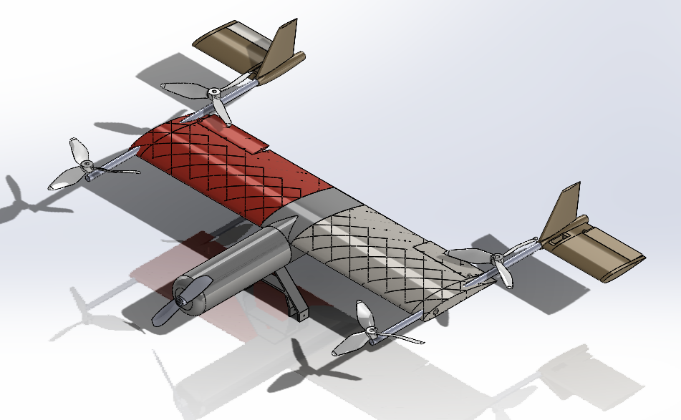
3D CAD Modelling
Generate CAD models for design concepts using SolidWorks
Validate design concepts
Derive theoretical values for Moments of Inertia and Center of Gravity from the 3D models

Slide 21
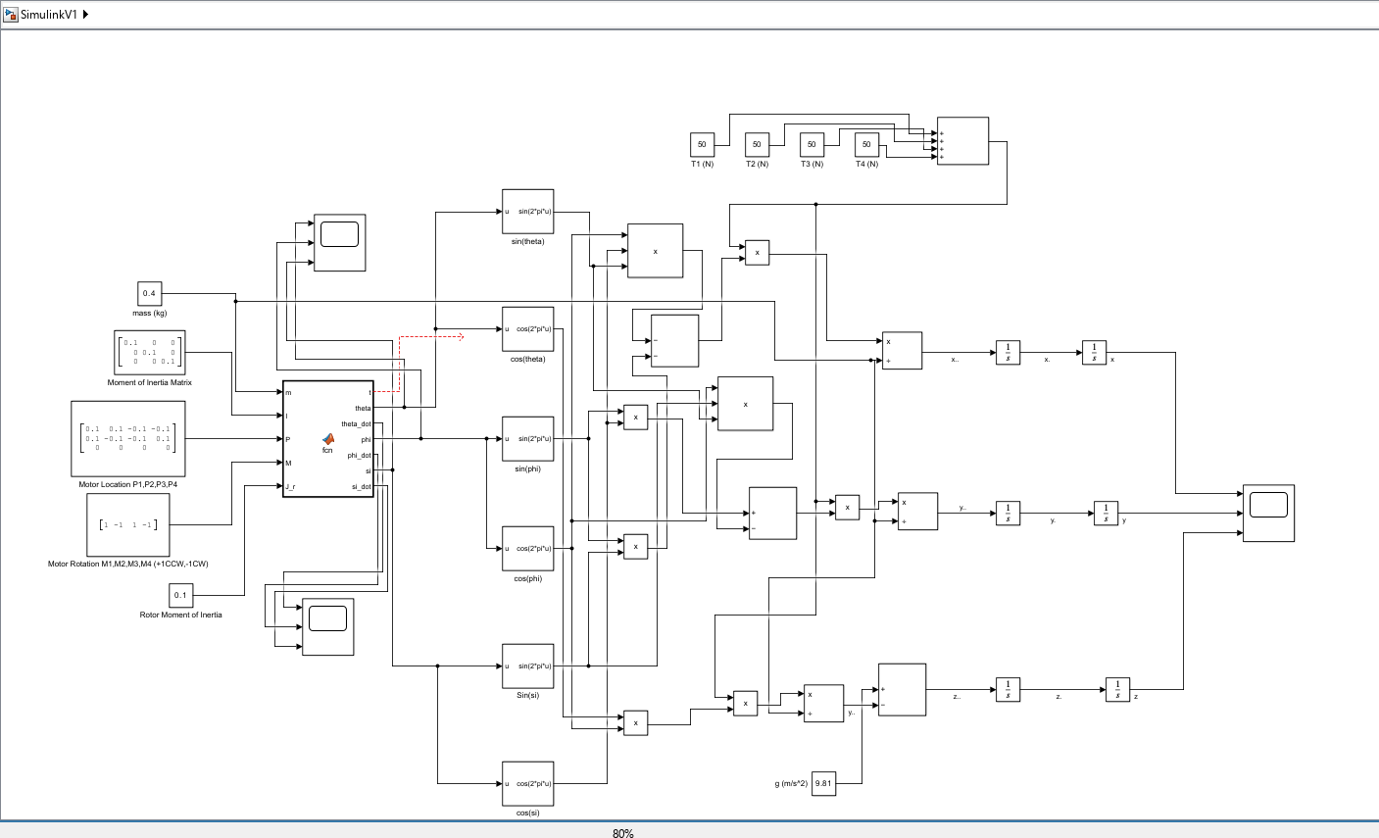
Thrust Code
MATLAB and Simulink used to model the dynamics of different concept designs
Uses mathematical values derived from both Motor Code and SolidWorks models
Uses initial input values of thrust to compute the dynamics of the drone in vertical flight (VTOL mode)
Compare different the efficiency of different concept designs

Slide 22

Controls Research
Considerations:
Weight (target <= 250g)
Cost (include $1000 budget?)
Thrust (F = mg)
Aerospace concepts
L/D ratio, CoL, CoD, stability (pitch, yaw, roll), etc.
Current Capacity (S.F. = 2)
ESC >> draw from motor and prop
S-rating
ESC > battery
Preliminary testing done with controls from provided 410 kits and MEGA 2560 kit
Separate systems for VTOL and forward flight vs rotating control system
Research topics:
4-in-1 speed controller
Lithium-ion battery
ESC receiver
Brushless motors (servo vs other)
ArduPilot for UAV autopilot system
*choose citation format - Motor, Propeller, ESC, and Battery Sizing Introduction, Matt Gerber,
http://www.maclab.seas.ucla.edu/people/matt-gerber/gerber211@ucla.edu
published Nov 2016, accessed Oct 2023

Slide 23
Communication & Project Management
Schedule and booking rooms for meetings
Take meeting minutes
Manage finances
Resource acquisition and management
Manage communications both internal and external

